Slide 1
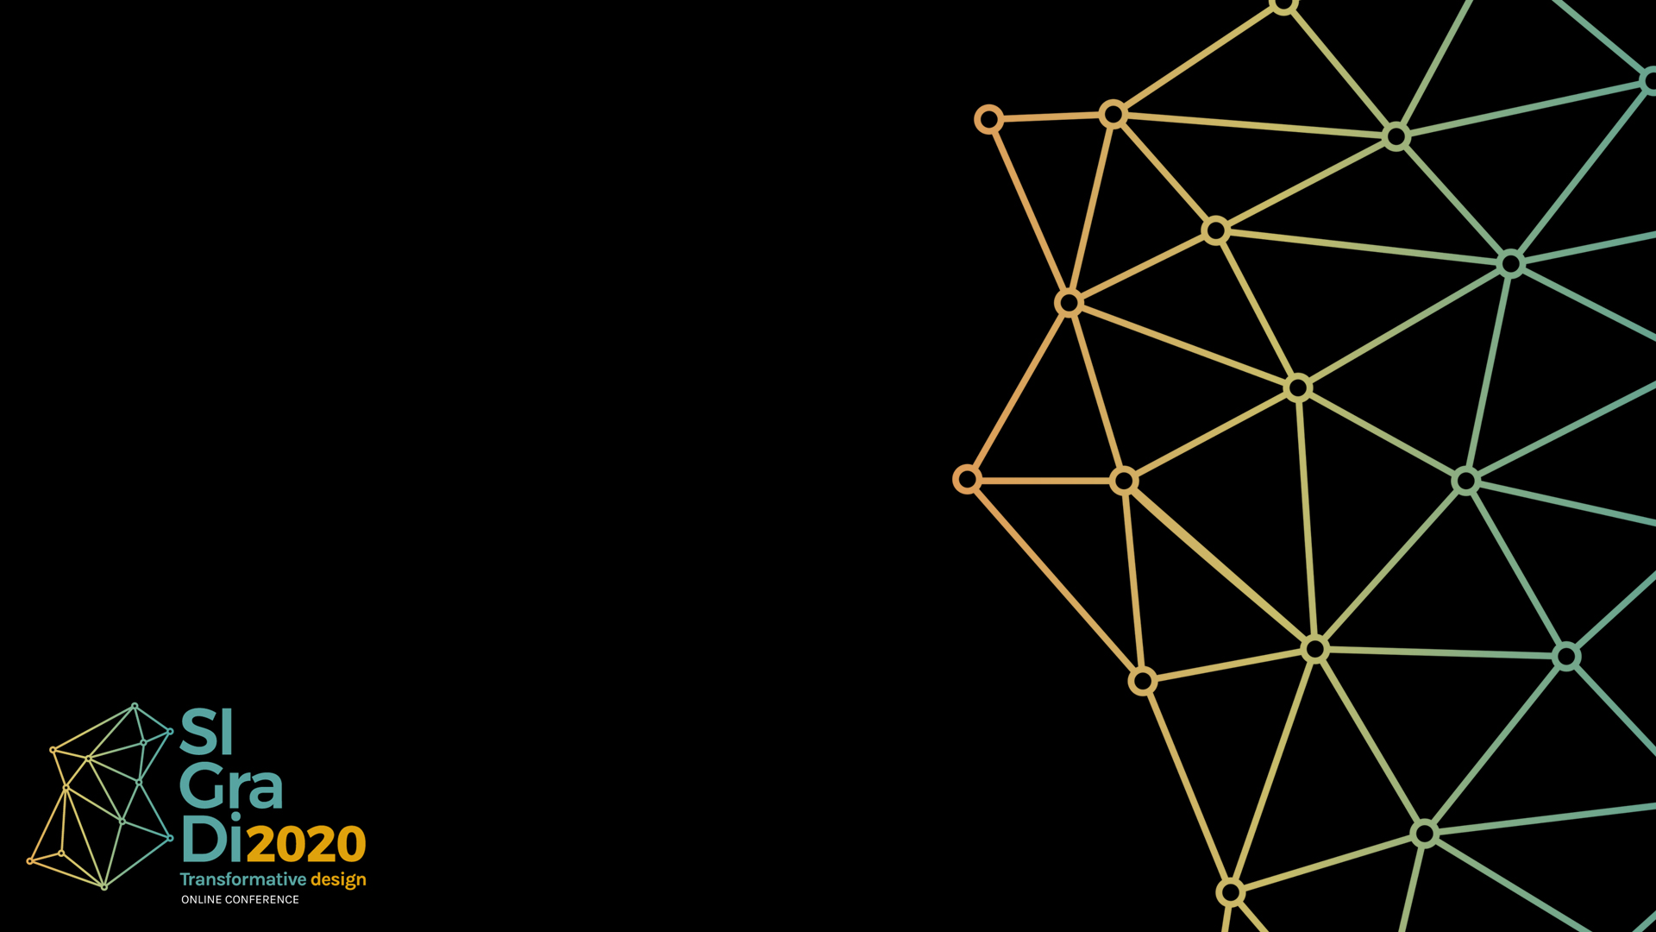
Blockchain Grammars for Validating the Design Process
Authors:
Dr. Davide Lombardi (Presenter 1)
Xi’an Jiaotong Liverpool University | China
Dr. Theodoros Dounas
Robert Gordon University | Scotland
Lok Hang Cheung (Presenter 2)
Xi’an Jiaotong Liverpool University | China
Dr. Wassim Jabi
Cardiff University | Wales

Slide 2

Introduction
This paper presents and develops the concept of Decentralised Autonomous Organisation (DAO)
as a platform for collaboration, via a design scenario in which Blockchain (BC) technology
is implemented for validation purposes.
Design scenario: Shape grammar | Environmental analysis | Building regulations
Proposals uploaded, stored, presented on DAO

Slide 3
Introduction
In a previous paper (Lombardi, Dounas 2019) we described and established a theoretical
mechanism for project governance using the Ethereum Blockchain, via the creation of a Decentralised Autonomous Organisation
i.e. an organisation that makes decisions via smart contracts that are executed on the Blockchain platform.
This study lays the foundation and ignites the development of a larger framework in which design collaboration and competition are fostered and results secured, impacting design value and financial transactions.

Slide 4
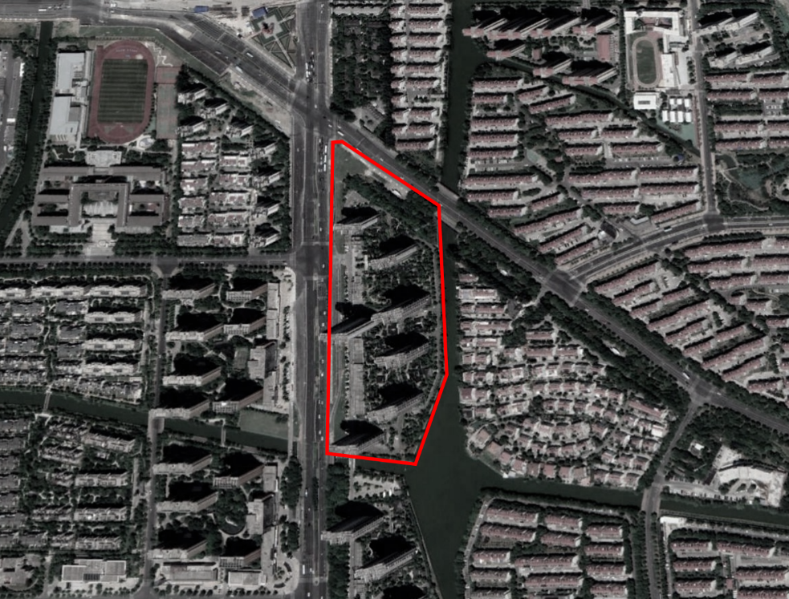
1. Case study introduction
Butterfly Bay is a residential compound in Suzhou Industrial Park.
It is based on the repetition of a
series of towers which its typology can be commonly found in most of the modern Chinese residential development
The monotony of the built environment provided the right
setting to establish a test-environment for us

Slide 5
2. Workflow - parameters and criteria
Jiangsu Province City planning and technical specification – Suzhou implementation detail 2 - "daylight analysis rules"
(2018 version)' 《江苏省城市规划管理技术规定--苏州市实施 细则之二 "日照分析规则" （2018 年版）》
Retrieved from http://www.zfxxgk.suzhou.gov.cn/sjjg/szsghj/201812/t20181207_1034143.html

Slide 6
1) we prepared the overall test and display environment;
2) design alternatives are generated by designers via
shape grammars and turned the final shapes into
buildings for simulation purposes;
3) we ran daylight simulations according to the
regulations as mentioned earlier and specifications;
4) we extracted data for the voting process on the DAO.
(Figure 1)
2. Workflow - Implementation

Slide 7
2. Workflow - design
design alternatives are generated by designers via
shape grammars and turned the final shapes into
buildings for simulation purposes;

Slide 8
2. Workflow – daylight analysis
ran daylight simulations according to the
regulations as mentioned earlier and specifications;

Slide 9
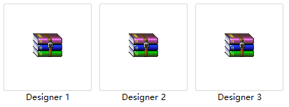
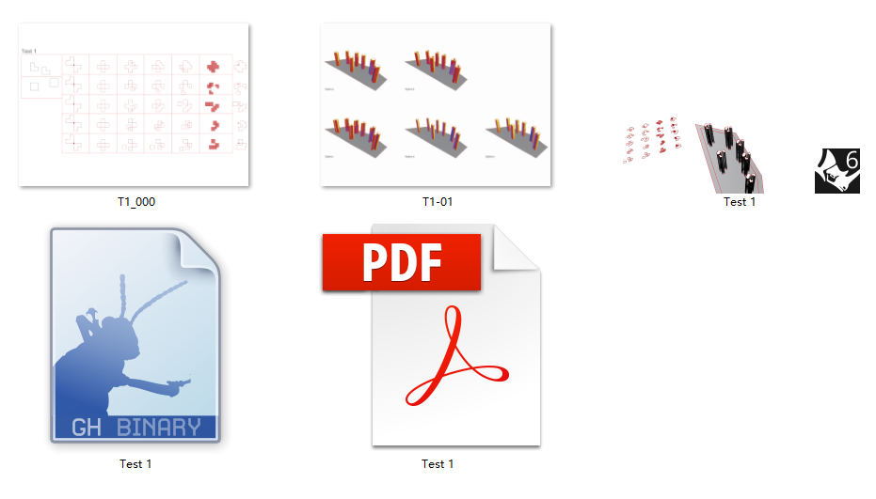
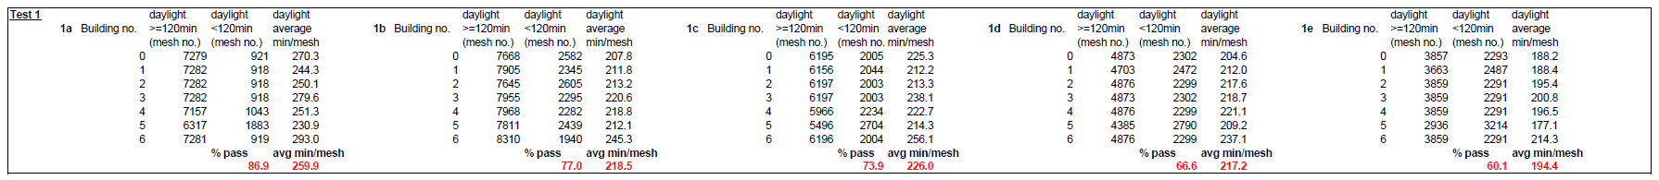
2. Workflow - package
we extracted data for the voting process on the DAO.

Slide 10
3. Competitive scenario

Slide 11
3. Competitive scenario

Slide 12
4. Voting on DAO

Slide 13
4. Voting on DAO
DAO as a platform
(i) menu
(ii) proposal content and the IPFS download link of the submission package
(iii) shows the voting for/against percentage.
Collaborative / competitive context
Smart contract option

Slide 14
4. Voting on DAO
Advanteges:
IPFS: No file size limit
provides opportunity to perform codes, hence also to potentially support CAD and BIM applications
ensure immutable recording of design decisions and transactions, ensuring the required trust in the process
Constraints:
Due to the inherent properties of the Blockchain system, uploading and getting a proposal synchronised can require more time than what users are used to
Unpredictable extra costs
User interface

Slide 15
5. Conclusion and next step
We have presented a two-steps-based integration of
design processes into a Distributed Autonomous
Organisation on the Ethereum Blockchain
The design scenario based on shape grammars
and sunlight simulation verified against real regulations,
provided the framework to simulate a potential real
situation for the clients and designers
More user-friendly user interface
Private and faster Blockchain
Looking forward to collaborate with built environment stakeholders

Slide 16
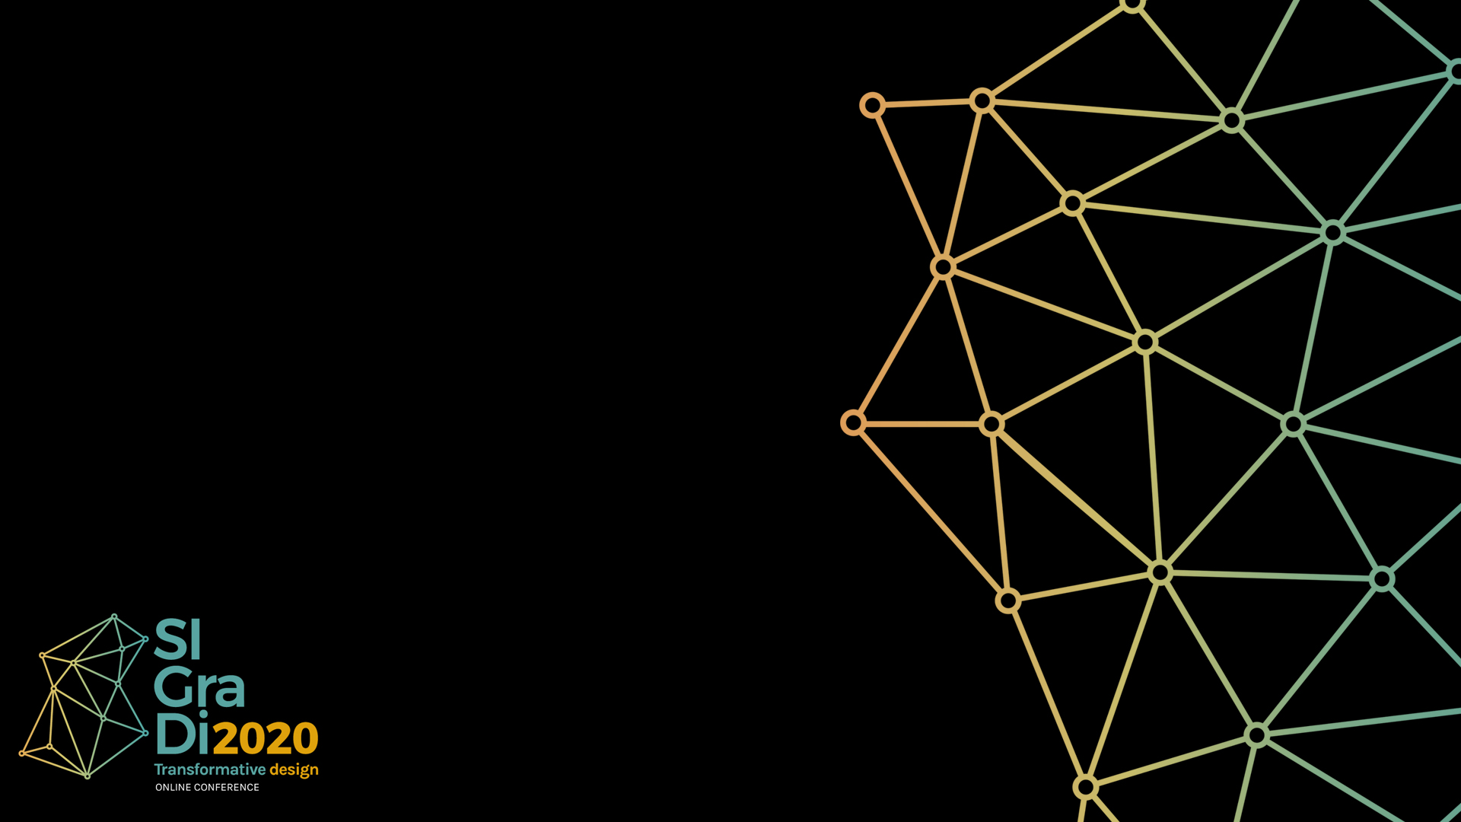
Thank you

